Slide 1
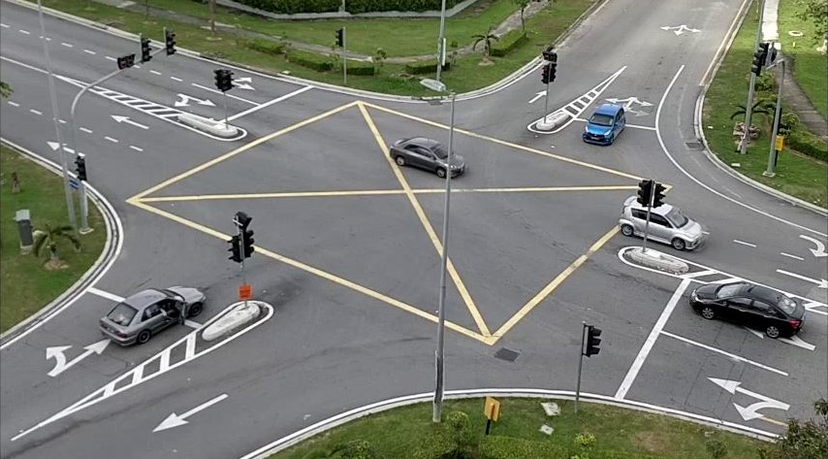
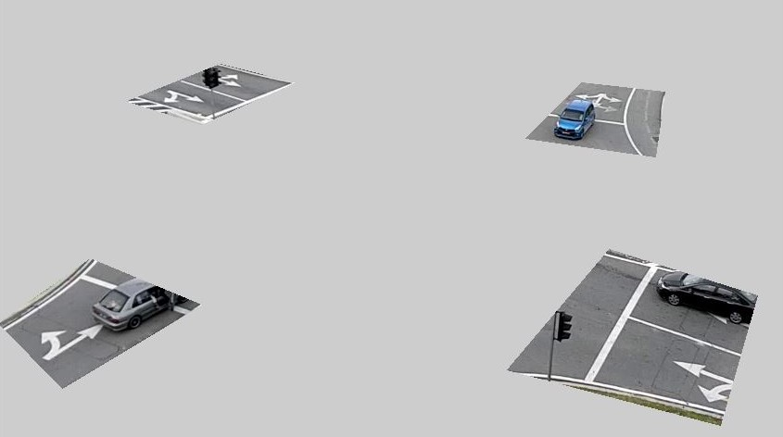
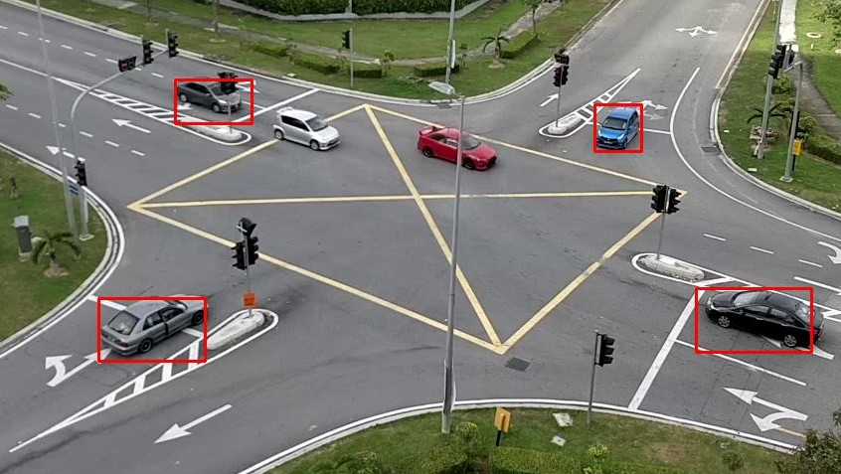

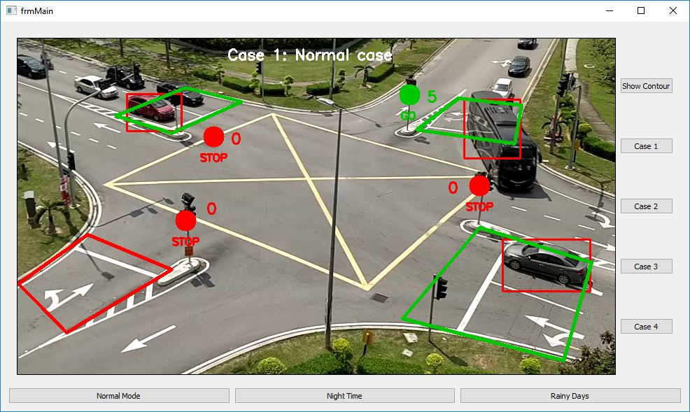
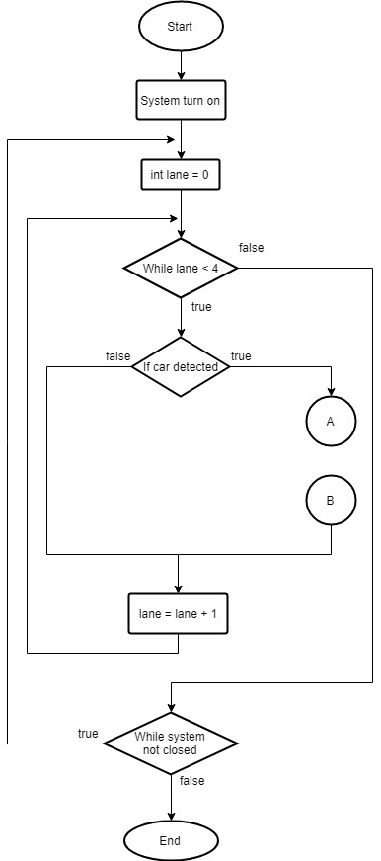
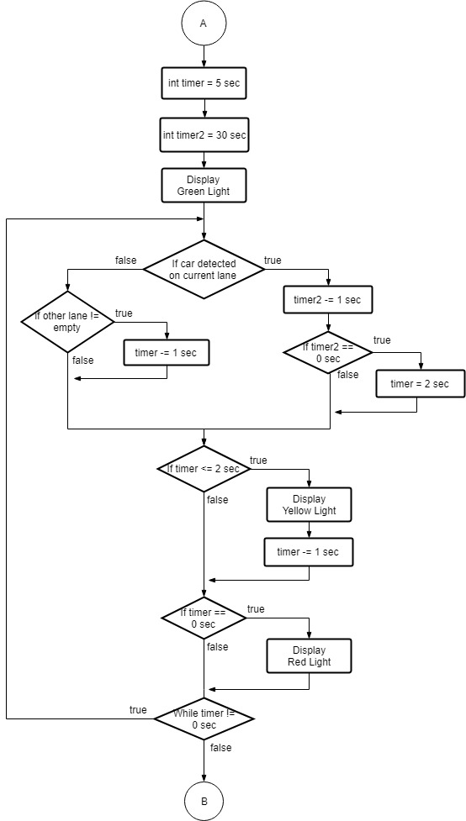
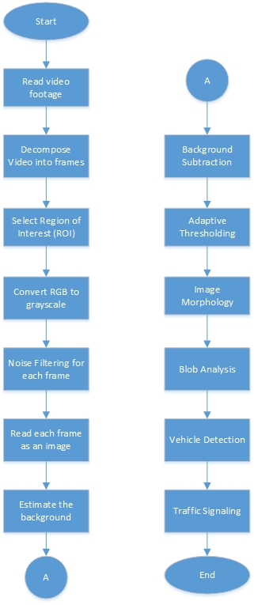
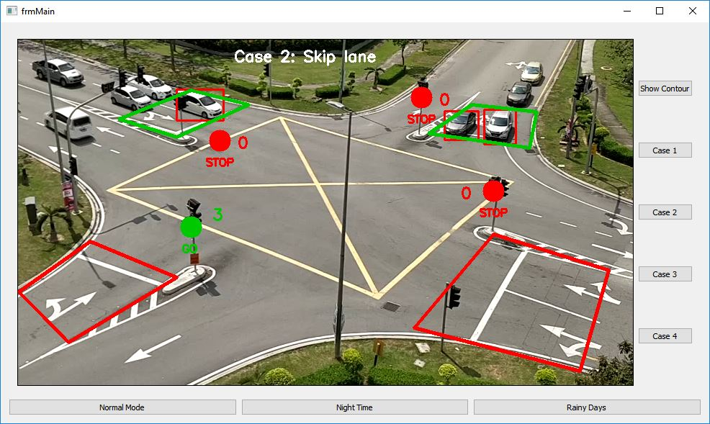
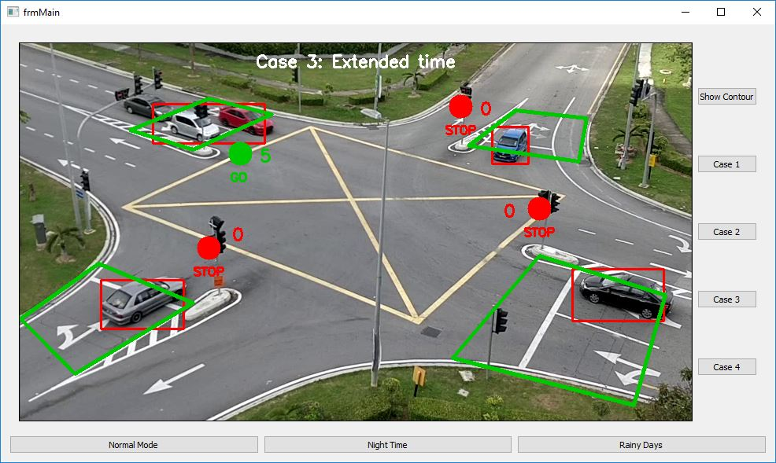
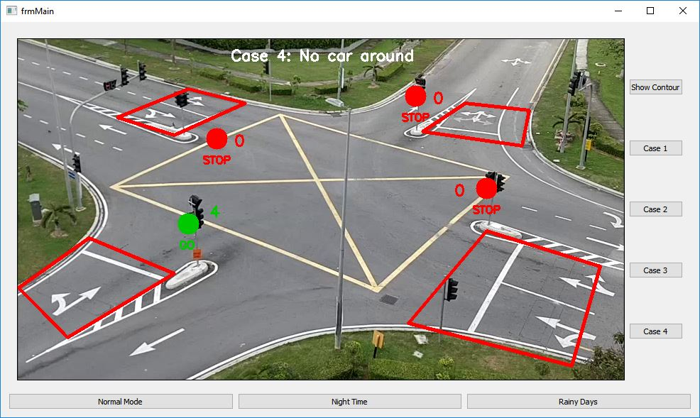
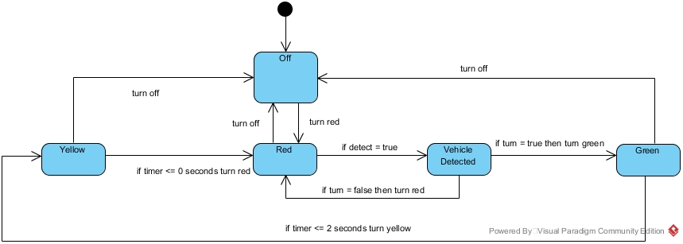
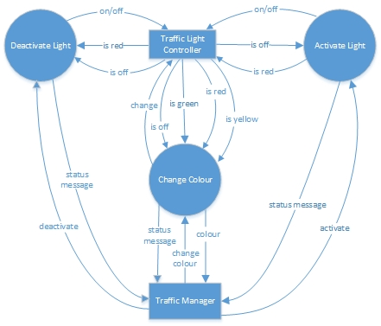

FYP ID: 711 Traffic Light Control System at Road Junction
ARSYAD BIN ANUAR, 1142700937
Supervisor: Dr. Junaidi Abdullah Moderator: Dr. Nabhan D. Salih
Abstract
Implementation / Testing or Key Concepts/Findings
In this modern day, urban traffic congestion has been spreading throughout the world due to the population of city and number of vehicles on the road increasing day by day. The need to control the streets, highways and roads cannot be neglected anymore. The main reason behind this problem is the techniques that are used for traffic light control system. Although there are many simpler techniques out there, such using fixed-timer control system. This technique has been proven ineffective as the traffic congestion has still not been reduced. Today’s traffic light control system has no emphasis on live traffic scenario which leads to inefficient traffic management systems. Therefore, we propose a system for controlling the traffic light by implementing video processing.
Original video file
ROI implementation
Problem Statement / Objectives
The problem statement of this project are as follows:
Commonly used fixed-timer control system is inefficient
Although dynamic control system is implemented, traffic congestion problem is still not solved
Dynamic control system is expensive to be installed and maintained
The project objectives are as follows:
Explore the existing problems at traffic light controlled junction
Proposed and develop algorithm to solve the identified problems based on video processing method
Blob tracking
Blob detection
Background study / Literature Review
Today, many theories and algorithms have been proposed to improve the traffic light control system. Either using software implementation or hardware implementation, both are very helpful in reducing traffic congestion problem. Some of the previous works are:
Satrughan Kumar et al – Implement the background subtraction algorithm and region of interest (ROI) implementation in traffic light control system
Sony Francis et al – Uses a Raspberry Pi module as the hardware traffic light controller and implementing image processing algorithm to control traffic signal timing
Parachita Basak et al – Implement the Sobel edge detection algorithm in traffic light control system along with image morphology technique and blob detection algorithm
The main screen
Methodology / Design or Research Methodology
Workflow of Video Processing
The algorithm
Case 1: Normal case
Case 2: Skip lane
Case 3: Extended time
Case 4: No car around
State Diagram
Conclusion
The key feature of this project is that it removes the need of expensive sensor by replacing with optical sensor that does not cost too much compared to others. It visualizes the reality, thus it works much better than those systems that rely on the detection of the vehicles’ metal content. The system is also easier to maintain compared to sensor control system. In conclusion, we have achieved our objectives in implementing video processing for traffic light control system to reduce traffic congestion problem but it still needs more improvement from time to time to achieve better accuracy and efficiency.
DFD
FACULTY OF COMPUTING AND INFORMATICS
Notes:
Empty Template

